Slide 1

Notes:
1:50

Slide 2
Application Synchronise vs Asynchronies
Application Synchronise : Application sends a message directly to another application example service call.
In this scenario if application 1 sends a message it just sends it and forget about it. There is a problem here .What about if application 2 is down ? Application 2 never receive a message . (Banking system or critical system when we lose 1 message it will be disaster
Asynchronies : means two application may not be up at the same time . For example application 1 is trying to send a message to application 2 but application 2 is down or its not available or there is a network problem then application 2 is not receiving a message . In Asynchronies communication is blocking call. In another word application 1 remains block till application 2 sends an acknowledgement
To avoid all this issue we use messaging system .
Is a data structure and application itself which receive the message stores it and when the receiving application is available ,it pulls the message from the queue.
The basis of messaging system is a queue or topic.

Slide 3
Publisher /Subscriber vs Point
to Point Communication
We have two types of communications : Point to points and Publisher /Subscriber communication
Point to points : Application 1 is a producer and application 2 is a consumer .Application 1 sends a message to queue and application 2 reads it from queue then deletes it from the queue.
Publisher /Subscriber : Client 1 sends a message to topic and any clients who has subscribed the topic will receive a copy of the message. One producer and multiple consumers.
Only clients who has subscribed to the topic to be able to get the message.

Slide 4
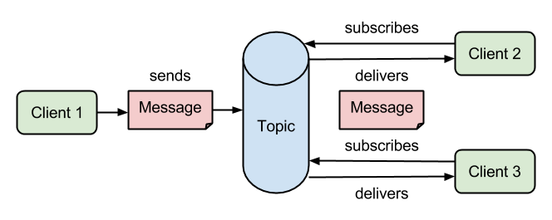
Publish/Subscribe Messaging

Slide 5
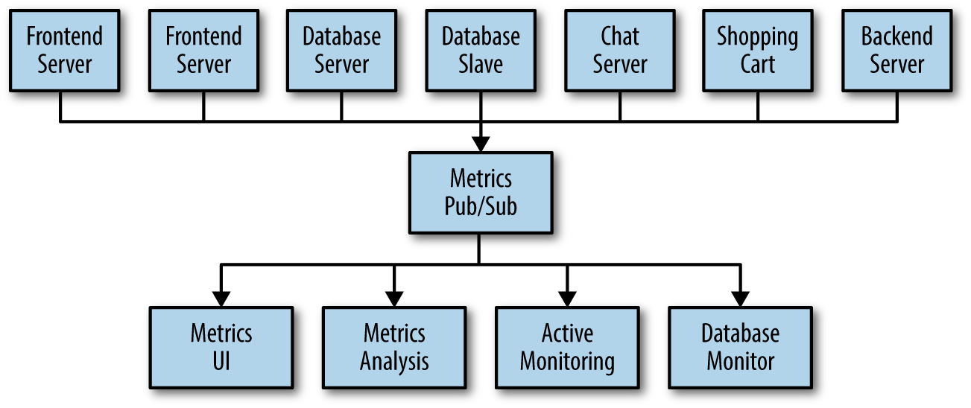
Publish/Subscribe Messaging - Advanced

Slide 6
Messages & Baches
The unit of data within Kafka is called a message.
A message is simply an array of bytes as far as Kafka is concerned, and hence has its contents have no meaning to it
A message can have an optional bit of metadata, which is referred to as a key
The key is also a byte array and, as with the message, has no specific meaning to Kafka
Keys are useful when messages need to be partitioned
For efficiency, a Kafka producer writes messages to a Kafka broker in batches
Batching is done because posting individual messages to the broker takes way too much time due to the network latency involved
Though, this reduces the throughput
Batches are also typically compressed, providing more efficient data transfer and storage at the cost of some processing power
Notes:
Hello ,Key : Any time we are sending a message Kafka sends a message or value along with

Slide 7
Topics & Partitions
A topic is where messages accumulate
Topics are broken down into partitions
Each partition has a commit log (log ,data structure which record entry of data and exits of data from each partition) associated with it
Messages are written to a partition in append-only fashion
Messages are read from a partition from the beginning
Order of messages are guaranteed within a particular partition, not across all the partitions of the topic
Since each partition can be hosted on different servers, it accounts for scalability

Slide 8
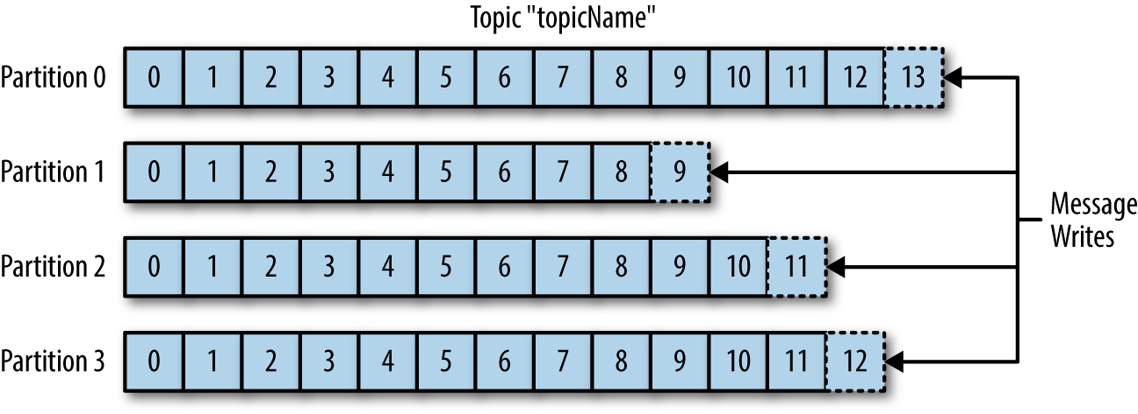
Topics & Partitions
Notes:
This is how the topics look like in Kafka .This topic has four partitions .When data is written to a particular topic ,based on the key .It uses Hash partitioning
For example you write a message with key 1 ,hash partitioning hashes the key (key 1) and figure it out that it has to go to partition 1 .Then comes message number 2 goes to partition 2 ,Message number 3 goes to partition 3 ,Message number 4 goes to partition 0 ,message 5 goes to partition 1 and so on . So the producer writing the messages and it does not know where are they going .It writing to topics.
Kafka will decide it which partition it should goes ? Based on the key . Everything happened in partition 1 is logged in commit log
In Kafka ,Topic is a logical concept ,Partition is a physical thing.
Ordering is maintained within particular partition
When it reads it reads it from the beginning and when it writes it writes it from ends. Producer puts it at the end and consumers reads it from beginning.

Slide 9
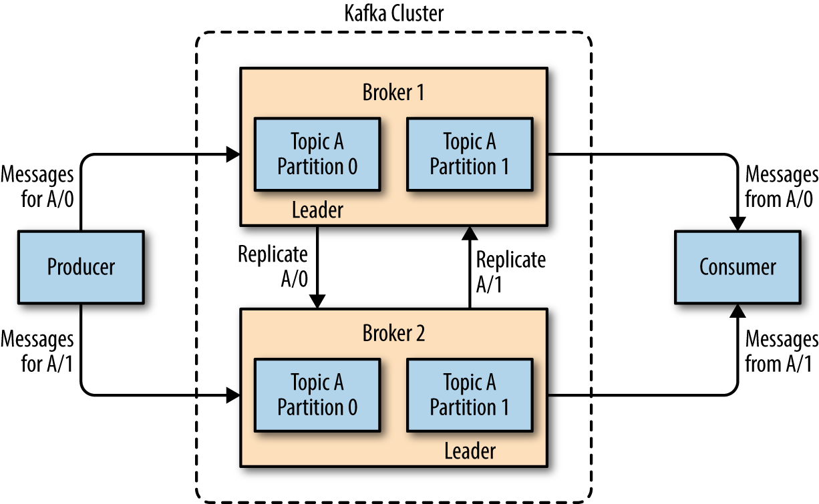
Brokers & Cluster
Notes:
Broker is JVM or a node. Kafka runs in a cluster .Kafka is a consist of multiple nodes and each node is a JVM.
Remember we had executer in Spark and within one executer we had multiple task similarly in Kafka we have brokers.
Each broker is a node in Kafka cluster .Broker has a copy of one or more partition on it.
Topic A has two partitions : Partition 0 and 1 .There is another broker which contains partition 0 and 1 why ? To provide redundancy
The replication factor of this topic is 2 means there will be two copies of each partition creates in kafka cluster .
Under replication :Replication factor is three but I have only two brokers.Kafka creates only two copies of the same partition because there are two brokers.
The moment we add new broker to the cluster Kafka will immediately put the third copies of the partition there .Everything is done automatically in few minutes.

Slide 10
Kafka Modules
Producers
Consumers
Kafka Connect
Kafka Streams
Notes:
Kafka Connect : where you can have a dynamic connection with any DB. If you have data written in DB Kafka can process is.(Google ,Facebook ,LinkedIn ,Yahoo do all things)
I BELIEVE LinkedIn produce Kafka.
Kafka streams is a mechanism which you can convert a none streaming data in to streaming data or streaming source. For example you have Kafka connect you read data from db then put it in to the topic then from that topic you do certain actions and you put it in another topic and become streaming source for you.
You can do any real time analytics on top of it.
Kafka is real time analytics (IoT) and Spark is near time analytics (there is delay in sending data and receiving a data).Kafka supports both .Spark does Micro batching .Waites for few second ,or minutes then process the entire batch

Slide 11
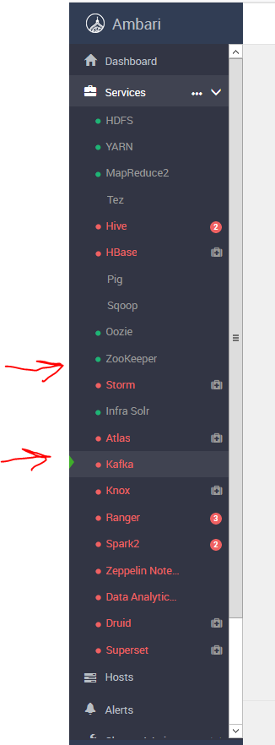

Slide 12
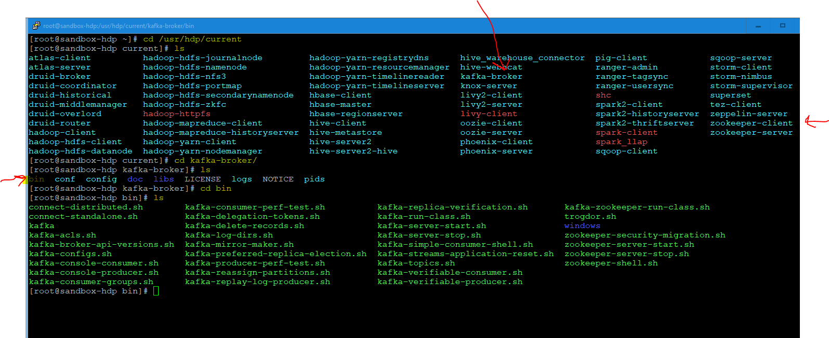
Kafka relays on something calls zookeeper
Zookeeper is distributed configuration management tools and belongs to Hadoop .For example if there is a shared configuration system that your Hadoop ecosystem need it then zookeeper can be your choice which you can store those information.
/usr/hdp/current/kafka-broker
You can start zookeeper from GUI
Notes:
Kafka relays on something calls zookeeper
Zookeeper is distributed configuration management tools and belongs to Hadoop .For example if there is a shared configuration system that your Hadoop ecosystem need it then zookeeper can be your choice which you can store those information.
/usr/hdp/current/kafka-broker
You can start zookeeper from GUI

Slide 13
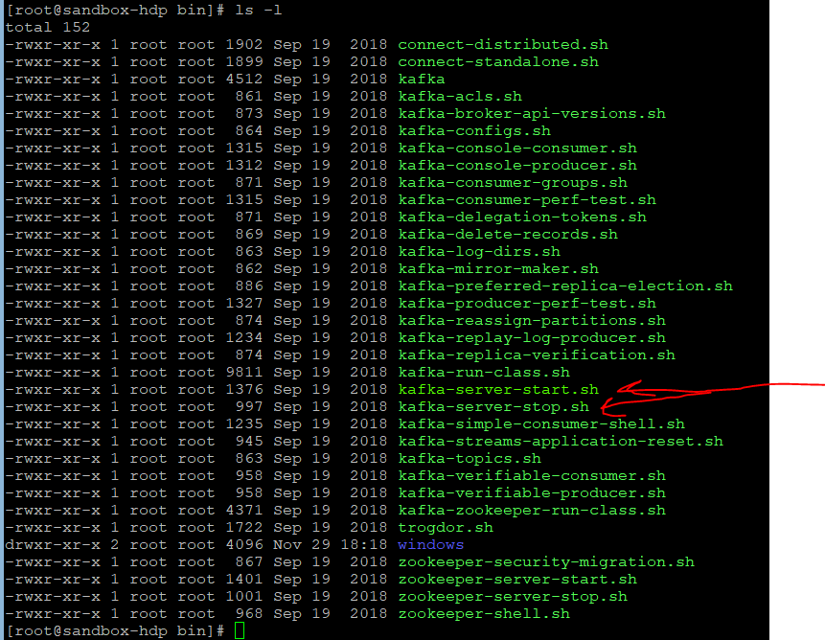

Slide 14
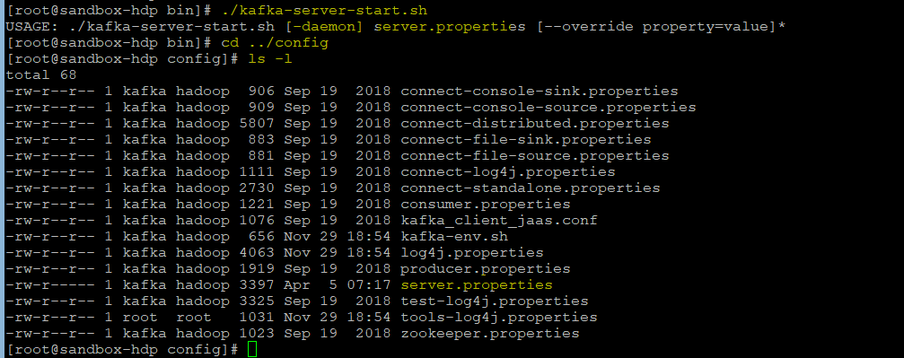
We start Kafka-services we need to specifies few thing like server.properties

Slide 15
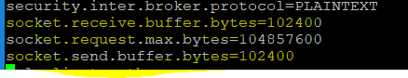
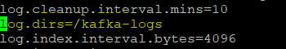
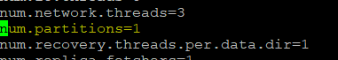
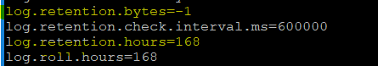
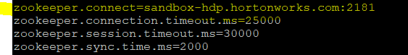
Notes:
6667 is the port in which my kafka server will run .Basically if producer and consumer have to connect to Kafka server this Kafka broker they have to connect to this port
Socket receive buffer :Every network port has buffer associated with it. (102400 is number of bytes.)
Socket send buffer :
Socket request max bytes :What is the maximum number of request come in .Request has payload
For this broker where is the log file.
Default number of partition is 1 that broker can have per topic.
Log retention hour : How many hours the message stay in Kafka before it is deleted.
Log retention byte : same concept but whatever come first it will take that
Where is my zookeeper running ? On local host on port 2181

Slide 16
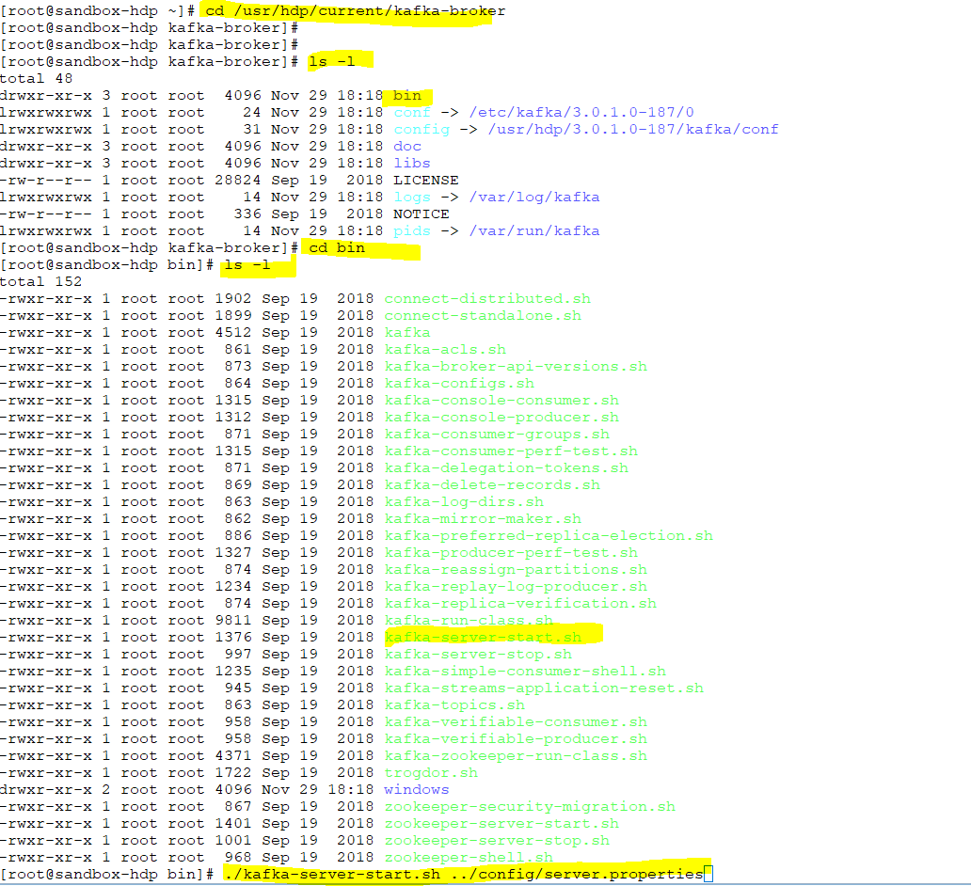
Notes:
/usr/hdp/current/kafka-broker

Slide 17
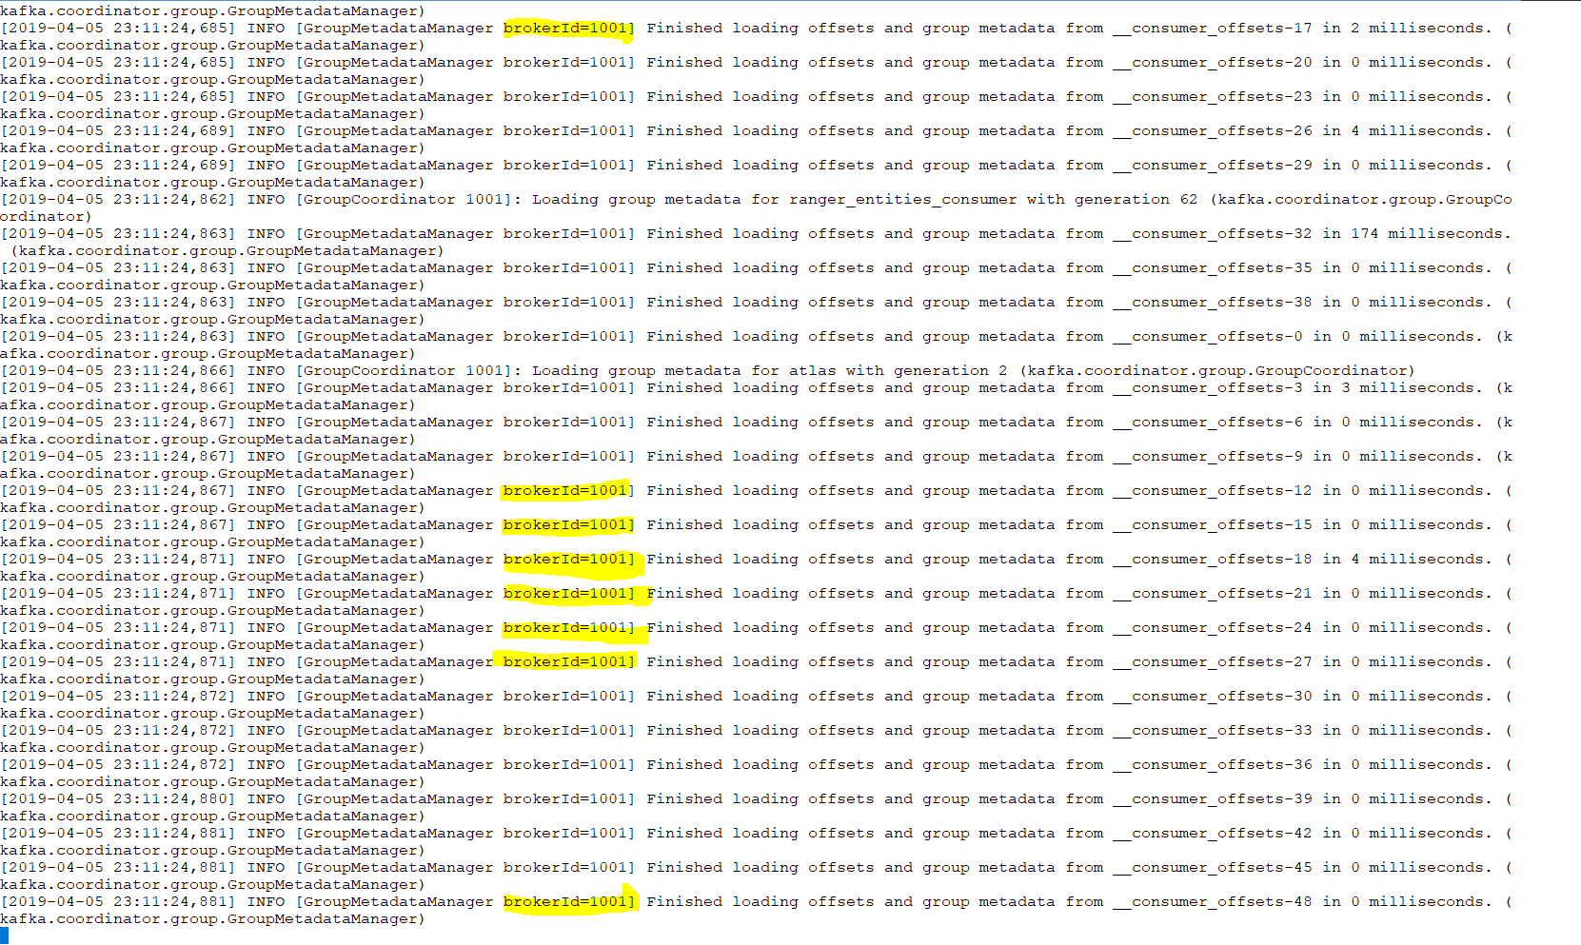
In my physical machine I am running Kafka cluster with a single broker.
Notes:
brookerId= 1001 means only one broker
In my physical machine I am running Kafka cluster with a single broker.

Slide 18
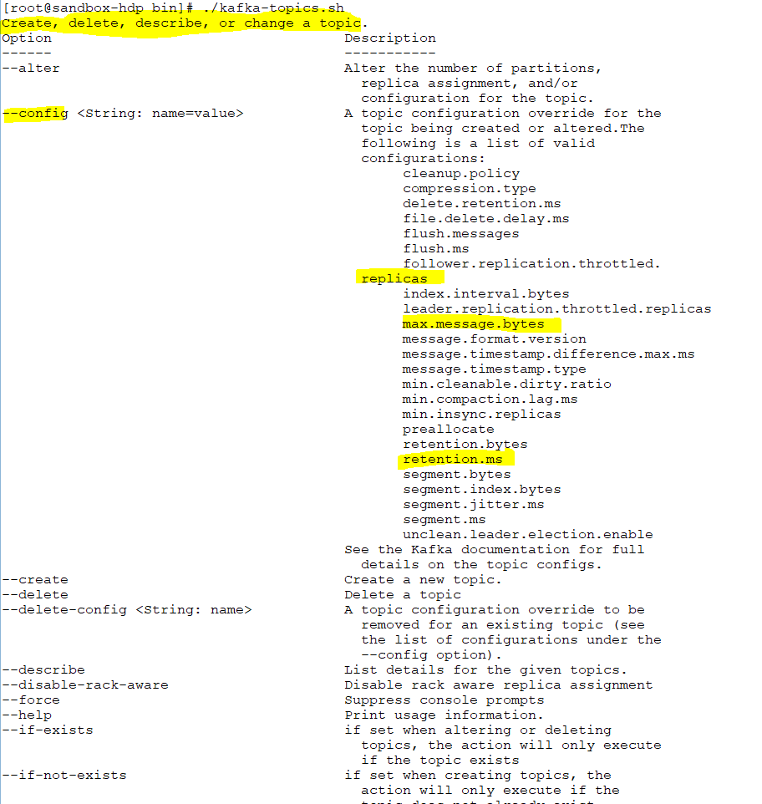
Notes:
Lets go and create a topic .

Slide 19
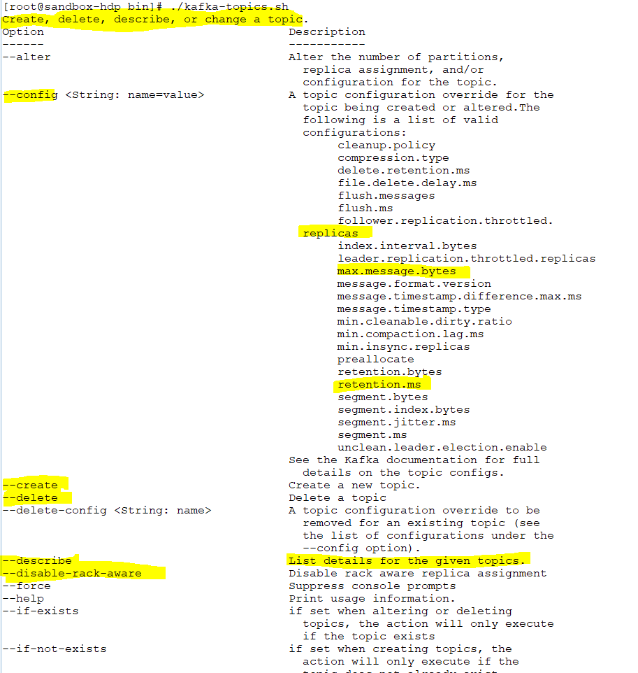
Notes:
Disable-rack-aware : interms of replica

Slide 20
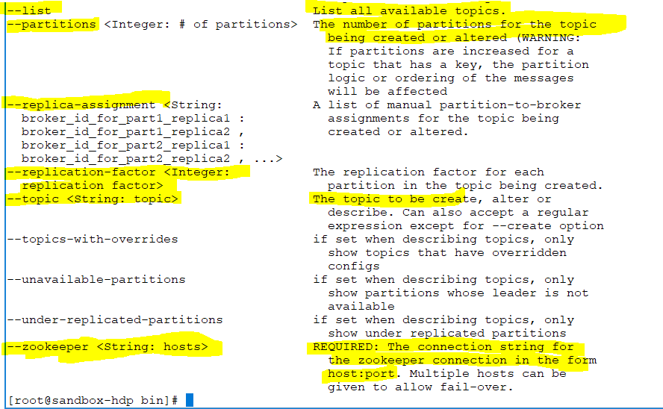
Notes:
Hadoop replica is 2 : each block has two copies of data
Kafka replication factor is 2 : there will be total of 3 copies .why ?the reason is Leader .
Leader means every partition of particular topic has a leader partition .Each replica has a leader partition .There is one primary partition and there are two follower partitions.
So if I say replication factor is 2 means there is one leader partition and two follower partitions
Leader partition is the partition where data is being read .When consumer read from a particular partition they read from leader partition . They do not read from all other partitions.
They do not read from all the copies from same partitions. why / because those are copies.
The follower partitions are trying to sync themselves to reader partitions. That is a silent replication happens within a kafka .Kafka does it by itself.You do not see it but it happens.

Slide 21
Notes:
I received an error because I am running only one broker but I specify the number of partition as 2 .
We can resolve it in two way : 1.creates another partition or use --under-replicated-partitions
./kafka-topics.sh --zookeeper localhost:2181 --create --topic test_topic --partitions 2 --replication-factor 2

Slide 22
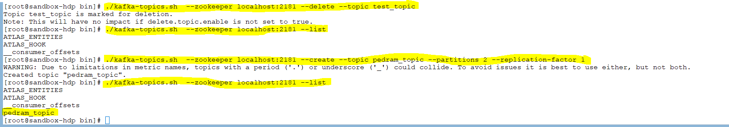

Slide 24
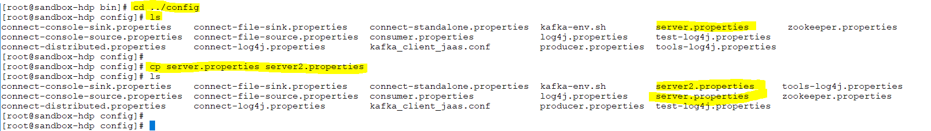
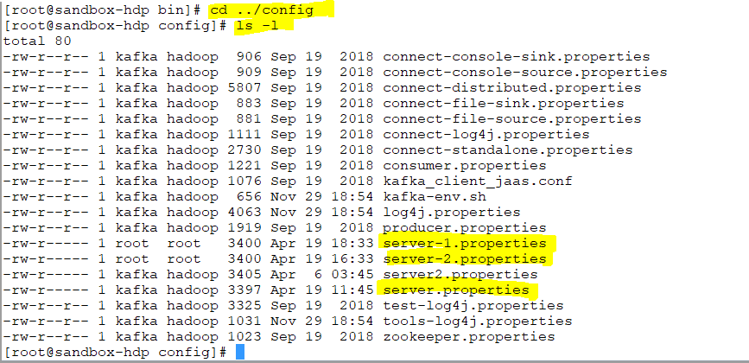
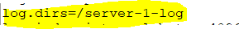
Notes:
Lets create another broker .To create another broker in the same machine I need to create a server.properties
/usr/hdp/current/kafka-broker
./kafka-topics.sh --zookeeper localhost:2181 --describe --topic pedram_test

Slide 25
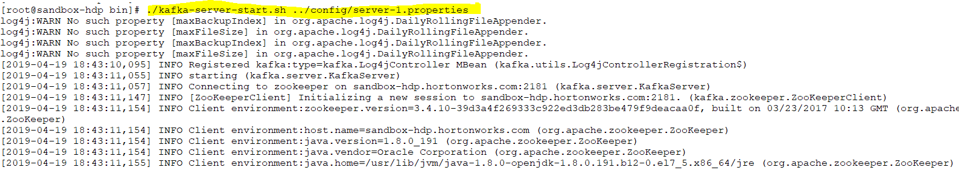
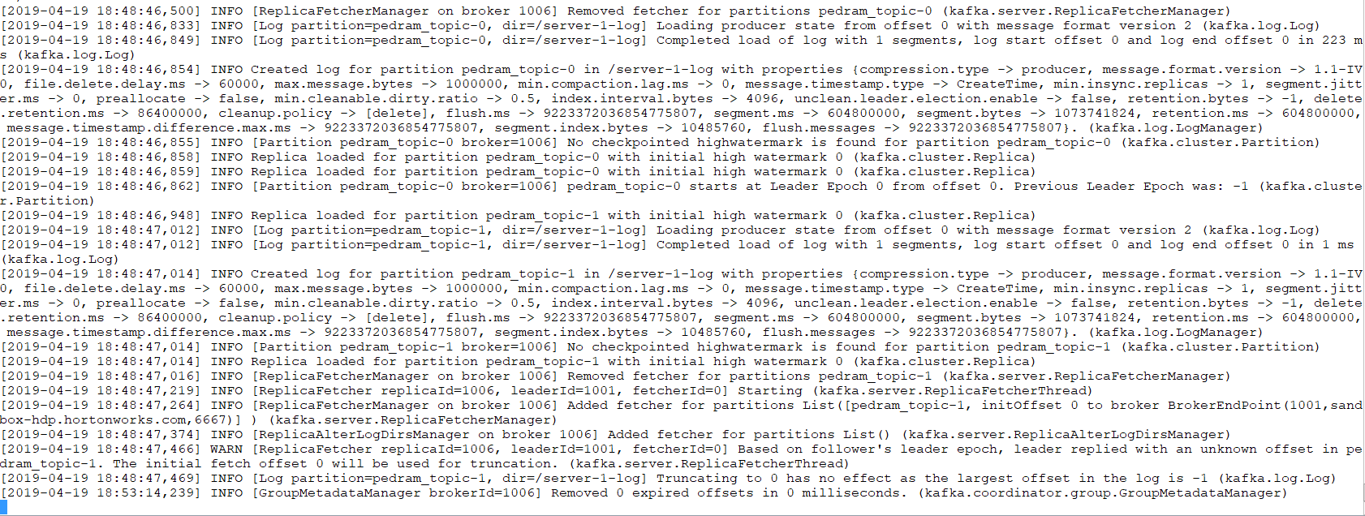
Create the second broker in the same machine

Slide 26
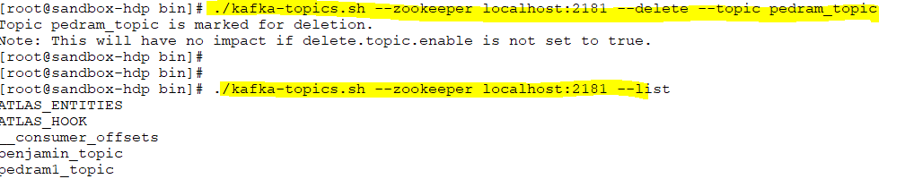
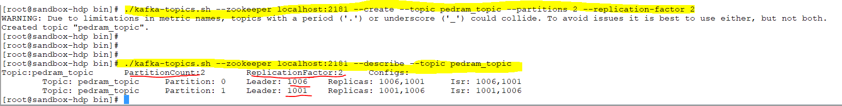
We delete the previous topic and we create again as the replication facto is different now.

Slide 27
Notes:
In the first diagram the replica is 1001 (replication factor 1)means we have only one replica of leader
In the first diagram the replica is 1001,1006 (replication factor 2)means we have only TW0 replica of leader

Slide 28
./kafka-server-stop.sh ../config/server.properties
As both brokers are in the same machine running this command will stop both of them so to avoid this , I just use ctrl+c
broker 1006
broker 1001

Slide 29
Before shut down broker 1006
After shut down broker 1006
Replica tells you the historic picture .What is supposed to be there .
In sync replica tells you what is currently there .

Slide 30
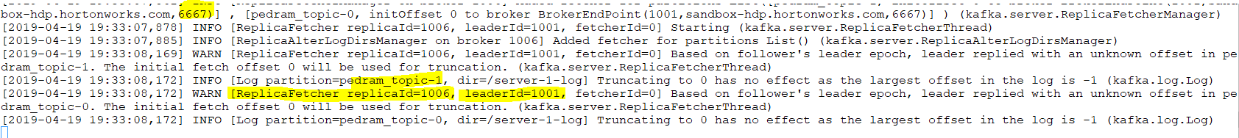
Bring broker 1 up again
Leader will still be 1001 (leader election)

Slide 31
Before shut down broker 1006
After shut down broker 1006
After bring up broker 1006

Slide 32
Kafka Topics - Demo
One Broker – Broker 0
Topic:pedram_test PartitionCount:2 ReplicationFactor:1 Configs:
Topic: pedram_test Partition: 0 Leader: 0 Replicas: 0 Isr: 0
Topic: pedram_test Partition: 1 Leader: 0 Replicas: 0 Isr: 0
Two Brokers – Broker 0 & Broker 1
Topic:pedram_test PartitionCount:2 ReplicationFactor:2 Configs:
Topic: pedram_test Partition: 0 Leader: 1 Replicas: 1,0 Isr: 1,0
Topic: pedram_test Partition: 1 Leader: 0 Replicas: 0,1 Isr: 0,1
Two Brokers – Broker 0 Up & Broker 1 Down
Topic:pedram_test PartitionCount:2 ReplicationFactor:2 Configs:
Topic: pedram_test Partition: 0 Leader: 0 Replicas: 1,0 Isr: 0
Topic: pedram_test Partition: 1 Leader: 0 Replicas: 0,1 Isr: 0
Two Brokers – Broker 0 Up & Broker 1 Up Again
Topic:pedram_test PartitionCount:2 ReplicationFactor:2 Configs:
Topic: pedram_test Partition: 0 Leader: 0 Replicas: 1,0 Isr: 0,1
Topic: pedram_test Partition: 1 Leader: 0 Replicas: 0,1 Isr: 0,1

Slide 33
If I have three broker and 4 partition how it will be distribute ?
Each broker has a limit to hold the number of partition.
Notes:
Each broker has a limit to hold the number of partition.

Slide 34
Architecture
At the core of Kafka is a topic
Each topic consists of multiple partitions
Each partition is an immutable ordered sequence of records
The ordered sequence is appended to a commit log
Each record in a partition has a position index associated with it known as the offset
Each record in a partition is retained up to a certain configurable period of time
The partitions are replicated over the cluster nodes according to a configurable replication factor
While distributed, one partition acts as the leader while the others act as followers

Slide 35
Offset 0
Offset 1
Within each partition each record has an offset
Offset is nothing than the position of the message or record within the partition
Notes:
Within each partition each record has an offset
Offset is nothing than the position of the message or record within the partition. Offset 0

Slide 36
Architecture
The leader serves as read-write requests while the followers passively replicate themselves to be in-sync with the leader
If the leader fails, one of the followers is chosen as the leader
The leader election is done by another Hadoop ecosystem component known as Zookeeper
The Zookeeper cluster maintains the state information for the Kafka cluster (decide who is the leader)
Each broker in the Kafka cluster acts as the leader for some partitions while acting as the follower for other partitions
Kafka implements the publish-subscribe model
Notes:
Leader reads and write

Slide 37
follower
For partition 0 read and write will happens on the broker 1006. The other partitions are sync with leader 1006 silently
For partition 1 read and write will happens on the broker 1001. The other partitions are sync with leader 1001 silently
Notes:
For partition 0 read and write will happens on the broker 1006. The other partitions are sync with leader 1006 silently
For partition 1 read and write will happens on the broker 1001. The other partitions are sync with leader 1001 silently
The other partitions are sync with leader 1001 silently

Slide 38
Producers
Producers write messages to a Kafka topic
They don’t care which partition the data would go to, though they may direct a particular message to a particular partition
If a Producer has to direct a particular message to a particular partition, it has to use a practitioner will hash the key of the message & then map it to a particular topic

Slide 39
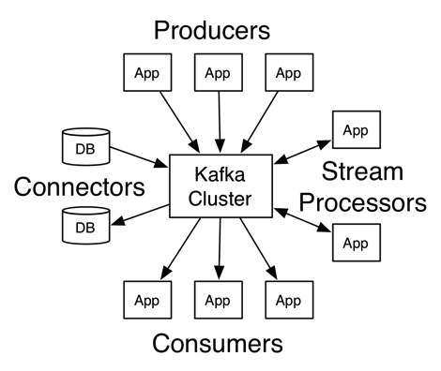
Features
Distributed streaming platform
Stream of records are stored in a fault-tolerant way
Used as a messaging system plus as a data storage channel
Consists of a central cluster and four API’s viz. Producer, Consumer, Connector & Streams

Slide 40
Consumers
Consumers read messages from a Kafka topic
Consumers maintain track of messages they have read from a particular topic using an offset
Each message in a particular partition is assigned an offset (sequence number) by Kafka
Offsets at a partition level for consumers is maintained in Zookeeper

Slide 41
Consumer Groups
Consumers that read from a single Kafka topic
Partitions of the topic are evenly distributed amongst the consumers in the group
The mapping of a consumer to a partition is often called ownership of the partition by the consumer
Ensures scalability in terms of the Consumers
If a particular Consumer fails, Kafka rebalances the distribution of partitions amongst the remaining consumers in the group

Slide 42
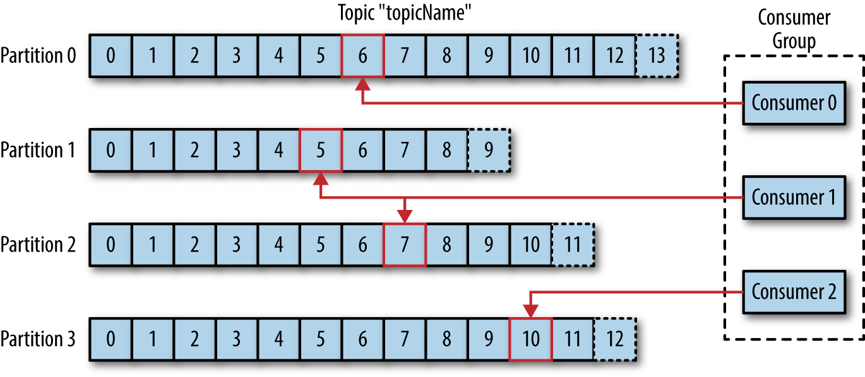
Consumer Groups

Slide 43
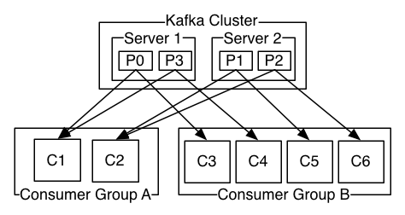
Consumer Groups

Slide 44
Producer & Consumer
Producer
Producers publish data to a particular partition of a particular topic
The data is automatically written to the leader partition
It is the responsibility of the producer to implement a partitioning mechanism of its data & then push it to the relevant partition
Consumer
Consumers belong to a consumer group
Each record in a topic is delivered to one instance in a particular consumer group

Slide 45
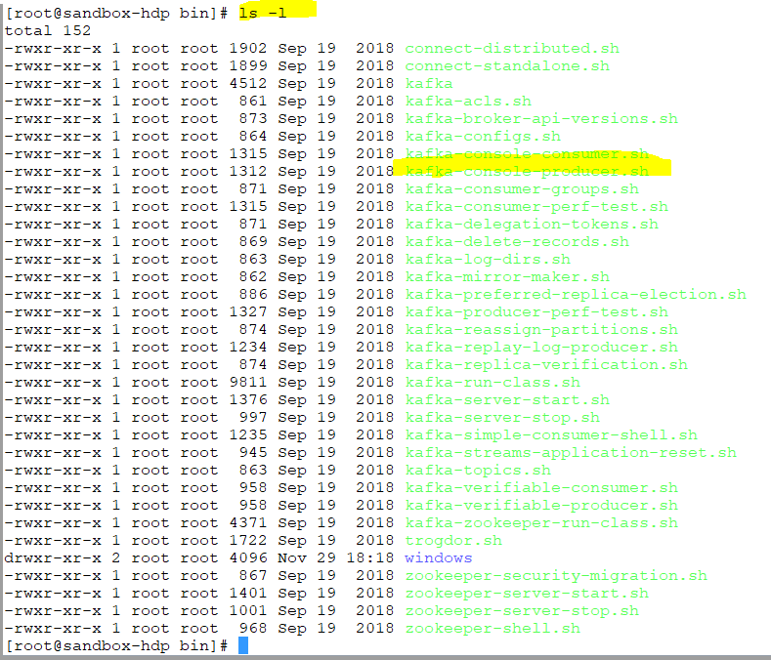
Console-producer is a command line tool to produce messages to Kafka
Notes:
Cosole-producer is a command line tool to produce messages to Kafka
cd /usr/hdp/current/kafka-broker/config
cd ../config
zookeeper 2181
listener : 6667
./zookeeper-server-stop.sh stop
./zookeeper-server-start.sh start
./kafka-server-start.sh ../config/server.properties
./kafka-server-stop.sh ../config/server.properties
./kafka-server-start.sh ../config/server-1.properties
./kafka-topics.sh --zookeeper localhost:2181 --list
./kafka-topics.sh --zookeeper localhost:2181 --create --topic pedram_topic --partitions 2 --replication-factor 2
./kafka-topics.sh --zookeeper localhost:2181 --create --topic pedram_topic --partitions 2 --replication-factor 1
./kafka-topics.sh --zookeeper localhost:2181 --describe --topic pedram_test
./kafka-topics.sh --zookeeper localhost:2181 --create --topic pedram_topic --partitions 2 --replication-factor 2

Slide 46
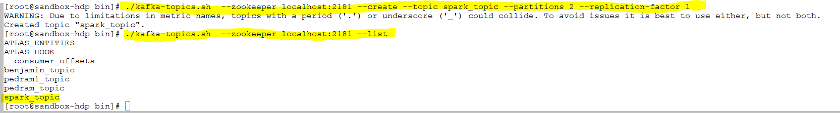

Slide 47
Three scenarios
Console consumer /App producer
Console producer /App consumer
App producer /App consumer

Slide 48

The Kafka code is written in Java so you need to install Eclipse for Java .

Slide 49
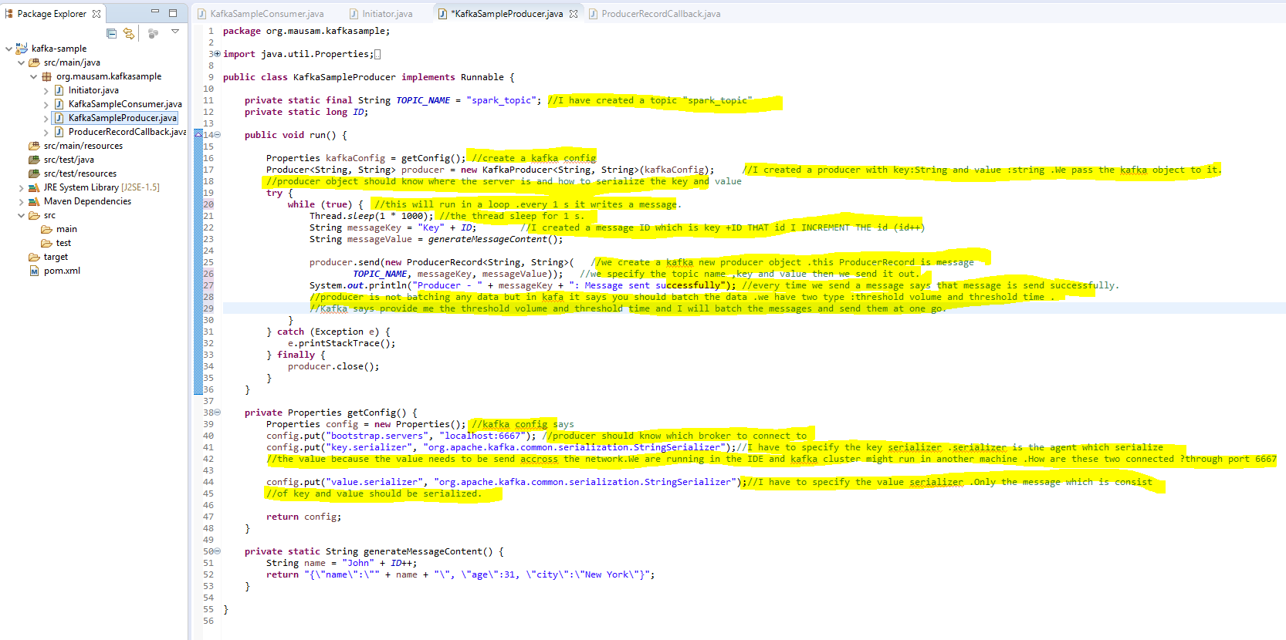
Console consumer /App producer
Notes:
Kafka put lots of emphasis on throughput .More throughput
Throughput : the amount of data which producer produce in to kafka topic.
In point to point messages producer sends a message to topic and consumer reads a message from topic and in publish /subscriber is same.
I n Kafka is different. Kafka says producer should not write messages one by one .It should write it as a batch .
Kafka producer has two configurable value :
1.Threshold volume :
2.Threshold time :

Slide 50
Example 1:
Volume threshold - 100 MB
Time Threshold - 60 sec
1 message /second –
Each msg -10 MB
10 SEC – 10 msg – 10 (10mb) =100 MB .It means your volume threshold will be reach first and it will send out all .Kafka producer does not send one message at a time.
Kafka producer will send batches of the messages then send them out.
============================================
Example 2:
Volume threshold - 100 MB
Time Threshold - 60 sec
1 message /second –
Each msg -1 MB
10 SEC – 10 msg – 10 (1mb) =10 MB
60 sec -60 msg -60 (1MB) -60 mb
So kafka producer will send 60 messages in 60 second to kafka broker.
Notes:
threshold volume :100 MB
threshold time :5 SECOND
WHICH one comes first .It sends the messages when one of the two conditions meet.assume we are producing a message every second 10 MB
==============================================================================================
Example 1:
Volume threshold - 100 MB
Time Threshold - 60 sec
1 message /second –
Each msg -10 MB
10 SEC – 10 msg – 10 (10mb) =100 MB .It means your volume threshold will be reach first and it will send out all .Kafka producer does not send one message at a time.
Kafka producer will send batches of the messages then send them out.
============================================
Example 2:
Volume threshold - 100 MB
Time Threshold - 60 sec
1 message /second –
Each msg -1 MB
10 SEC – 10 msg – 10 (1mb) =10 MB
60 sec -60 msg -60 (1MB) -60 mb
So kafka producer will send 60 messages in 60 second to kafka broker.
How do we make sure we receive the messages ?

Slide 51
Console-producer is a command line tool to produce messages to Kafka
Notes:
Cosole-producer is a command line tool to produce messages to Kafka
cd /usr/hdp/current/kafka-broker/config
cd ../config
zookeeper 2181
listener : 6667
./zookeeper-server-stop.sh stop
./zookeeper-server-start.sh start
./kafka-server-start.sh ../config/server.properties
./kafka-server-stop.sh ../config/server.properties
./kafka-server-start.sh ../config/server-1.properties
./kafka-topics.sh --zookeeper localhost:2181 --list
./kafka-topics.sh --zookeeper localhost:2181 --create --topic pedram_topic --partitions 2 --replication-factor 2
./kafka-topics.sh --zookeeper localhost:2181 --create --topic pedram_topic --partitions 2 --replication-factor 1
./kafka-topics.sh --zookeeper localhost:2181 --describe --topic pedram_test
./kafka-topics.sh --zookeeper localhost:2181 --create --topic pedram_topic --partitions 2 --replication-factor 2

Slide 52
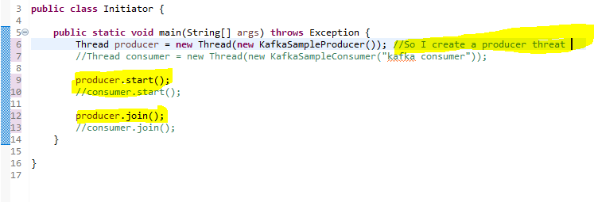
[root@sandbox-hdp bin]# ./kafka-console-consumer.sh --bootstrap-server localhost:6667 --topic spark_topic --from-beginning
Notes:
[root@sandbox-hdp bin]# ./kafka-console-consumer.sh --bootstrap-server localhost:6667 --topic spark_topic --from-beginning
Kafka console consumer is also outside the kafka cluster so they do not need zookeeper .They need to know the url of broker to connect to .Thats why I need to write the bootsrap server
Why bootstrap.servers ? Because you can point to many broker .If consumer is not able to connect to the first broker it will try to connect to the next broker .
We also need to tell from which offset it w

Slide 53
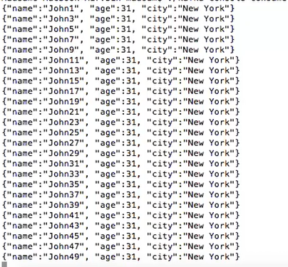
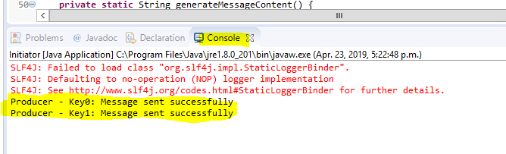
[root@sandbox-hdp bin]# ./kafka-console-consumer.sh --bootstrap-server localhost:6667 --topic spark_topic --from-beginning
Notes:
In one hand I am producing to this spark topic and here in this console I am reading from topic

Slide 54
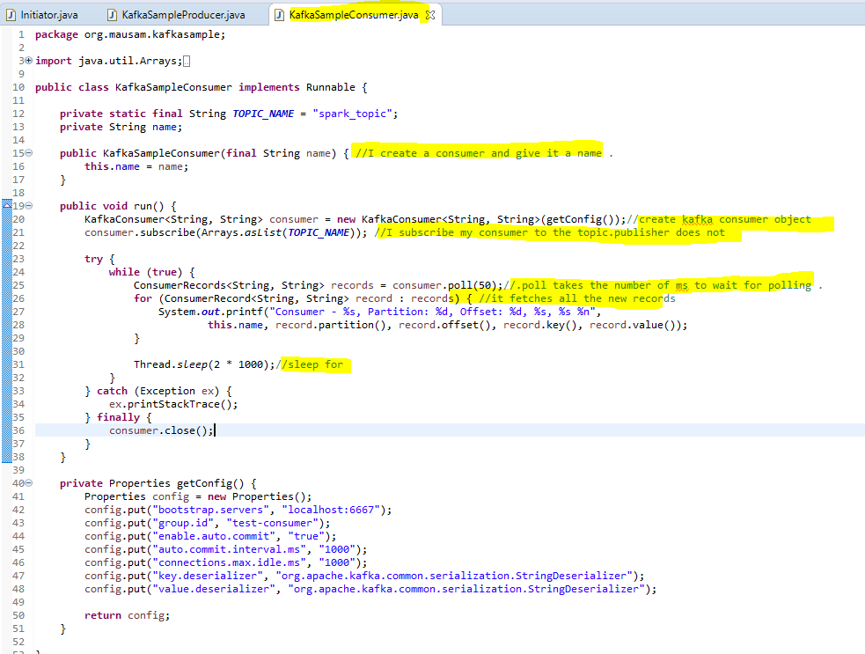
Console producer /App consumer
Notes:
Java API of Kafka is much better .easier to understand.

Slide 55
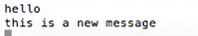
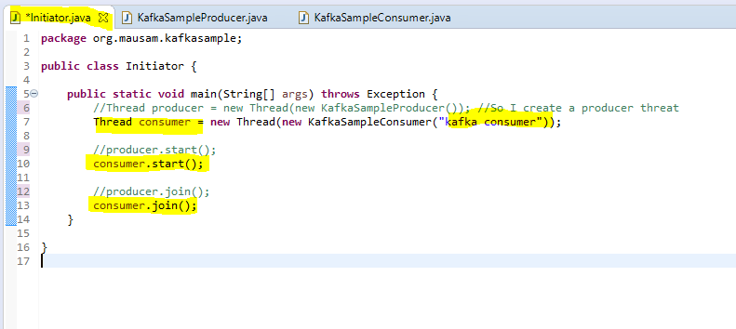
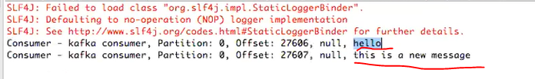

Slide 56
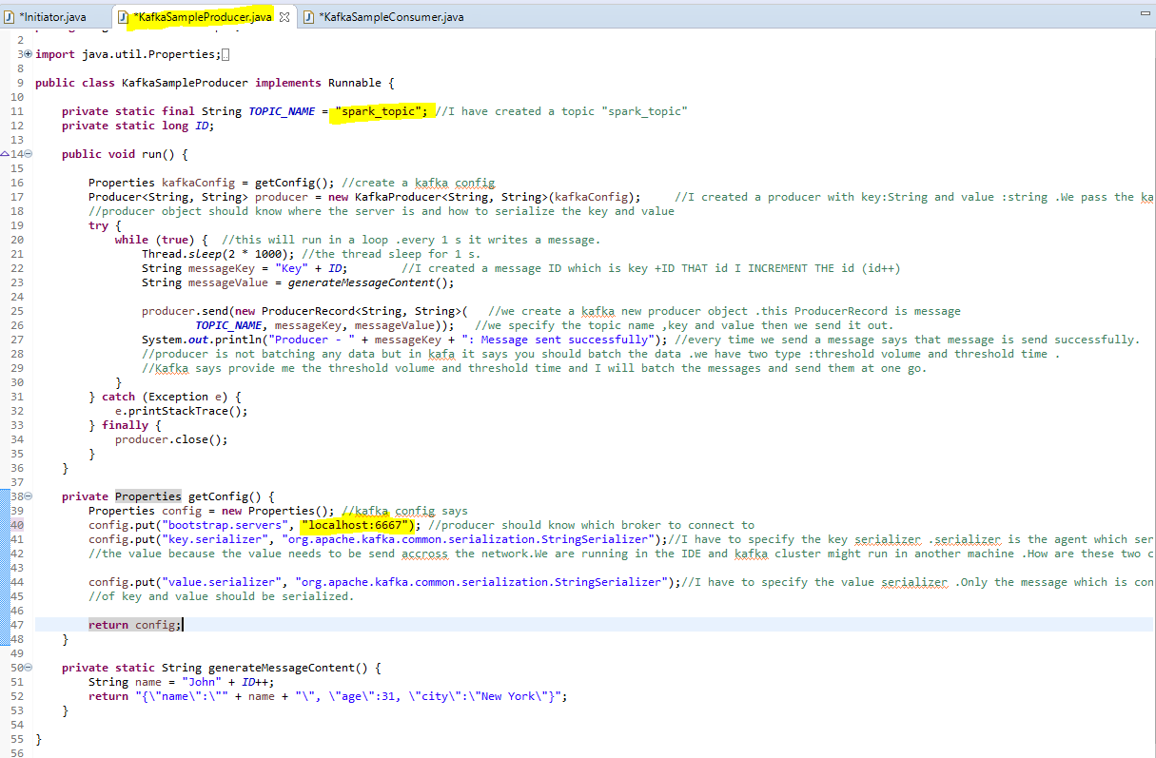
App producer /App consumer

Slide 57
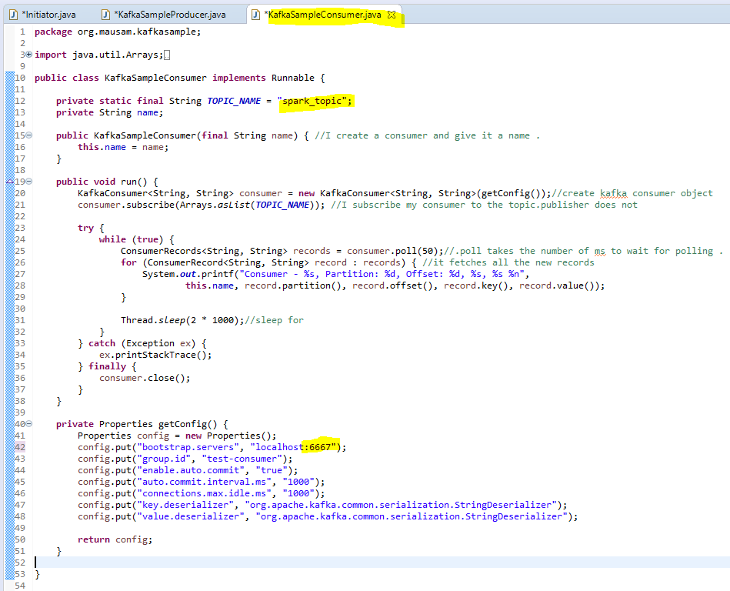

Slide 58
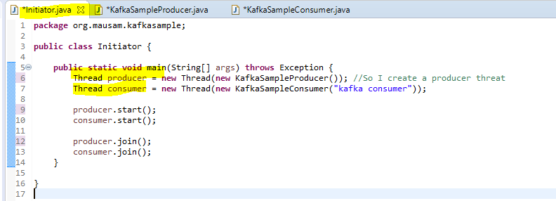
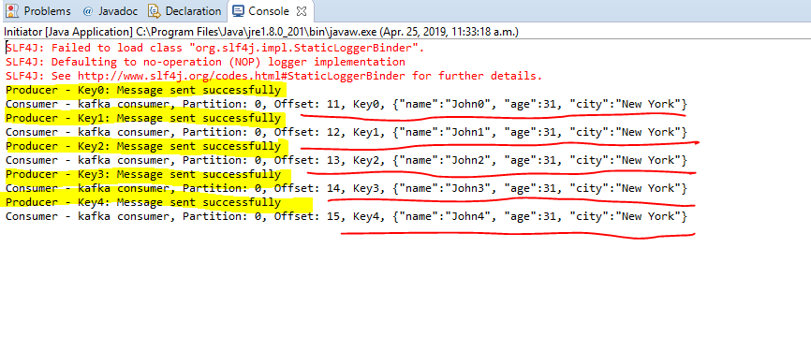

Slide 59
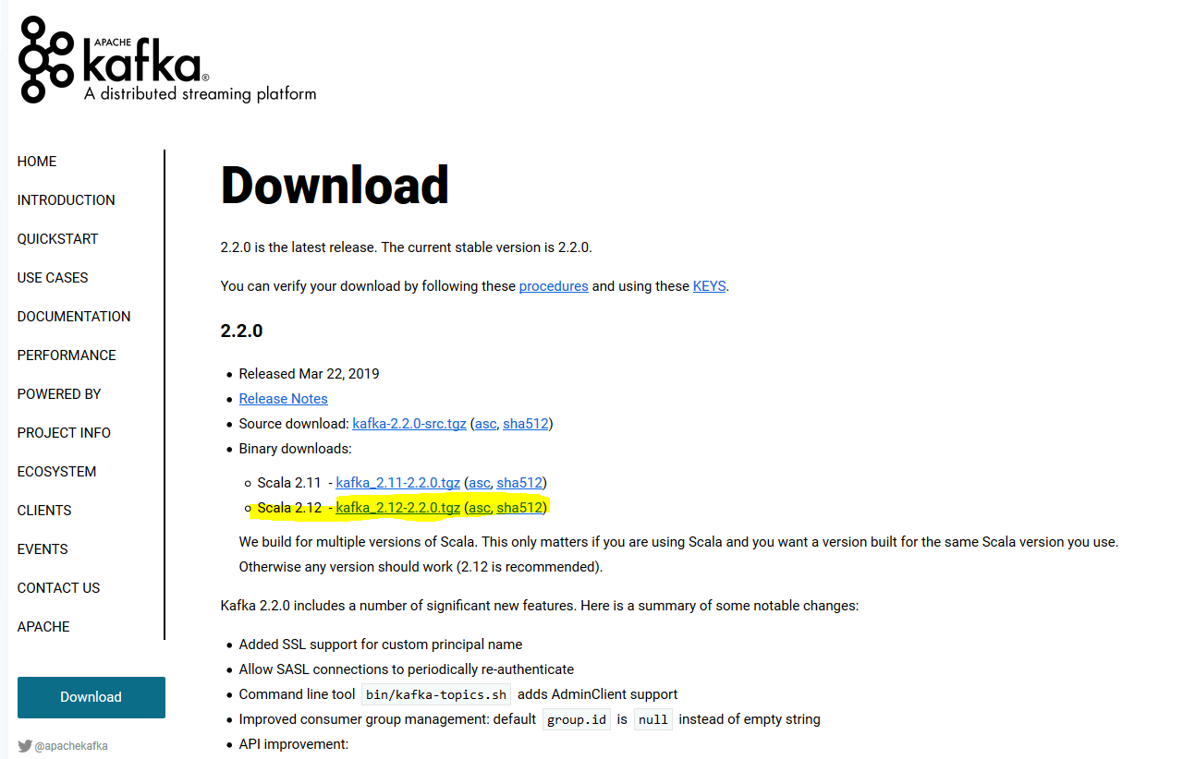
https://kafka.apache.org/downloads

Slide 60
Kafka Streams - Installing Kafka on Windows
https://www.youtube.com/watch?v=TTsOoQ6_QB0

Slide 61
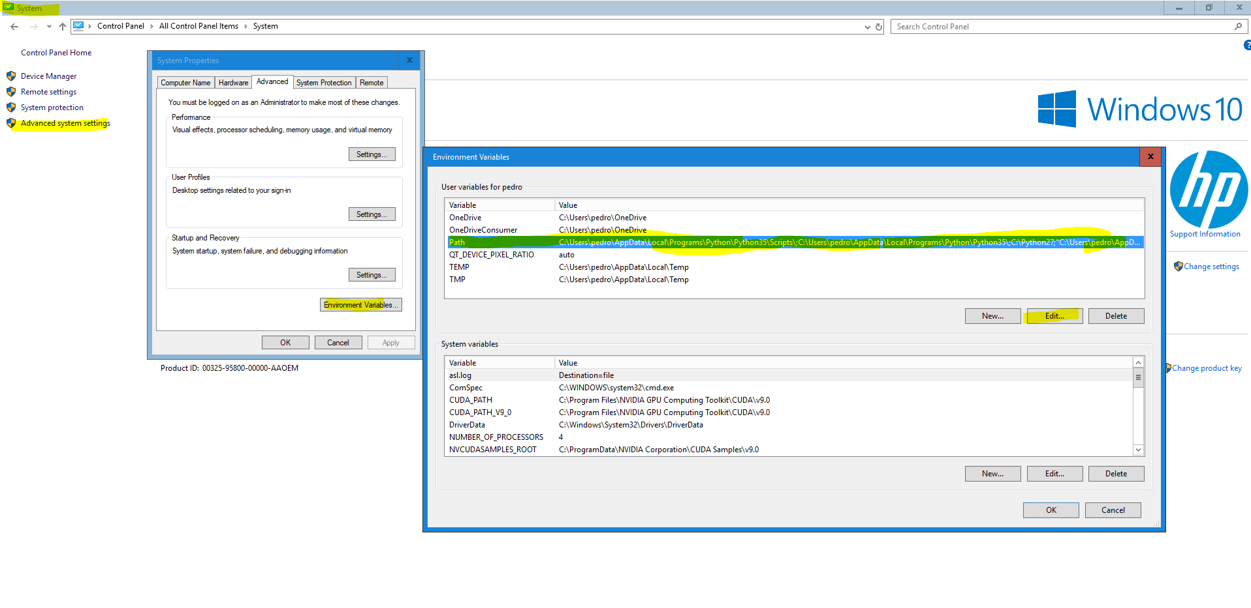
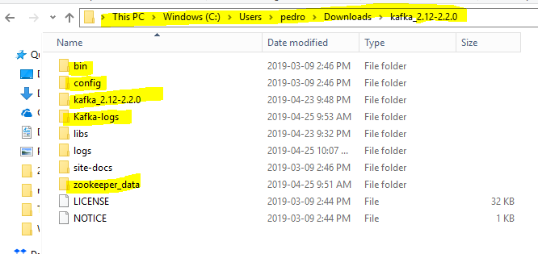
Notes:
Create two folders :
Kafka-logs and zookeeper_data

Slide 62
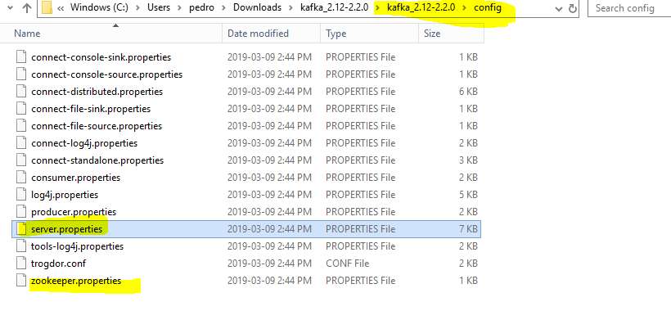

Slide 63
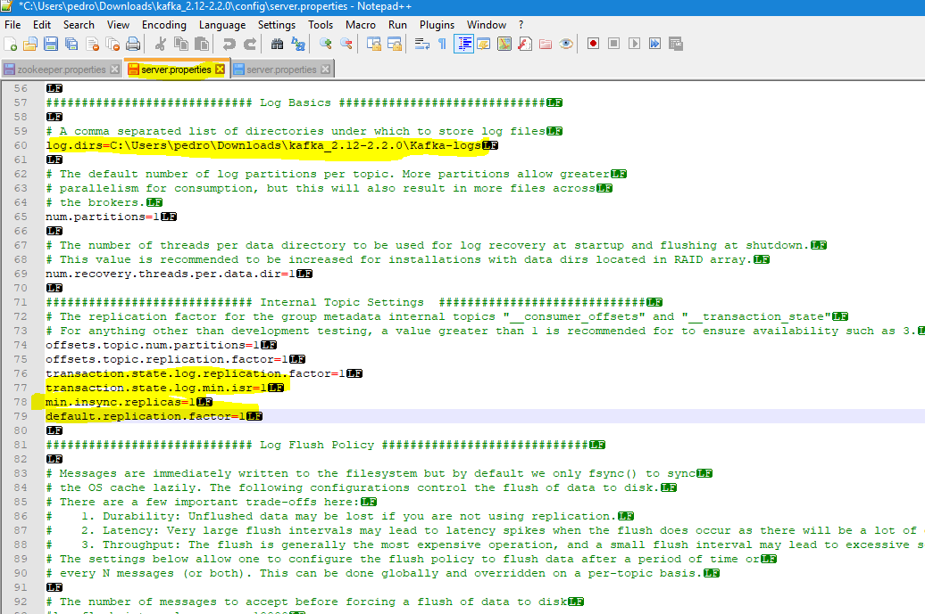
Notes:
Install Kafka in Windows

Slide 64
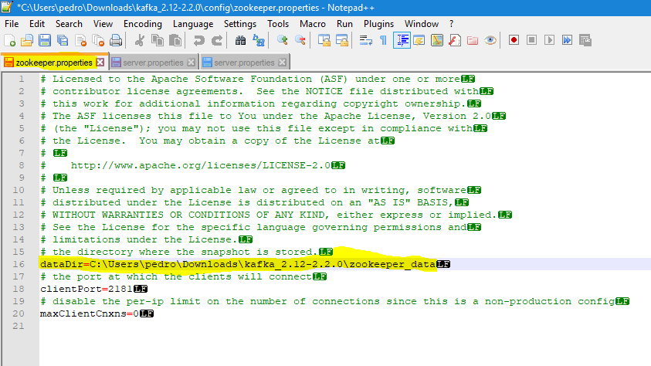
Notes:
Install Kafka in Windows

Slide 65


Slide 66


Start zookeeper then Kafka server
Notes:
zookeeper-server-start.bat C:\Users\pedro\Downloads\kafka_2.12-2.2.0\config\zookeeper.properties

Slide 67


Start zookeeper then Kafka server
Notes:
kafka-server-start.bat C:\Users\pedro\Downloads\kafka_2.12-2.2.0\config\server.properties

Slide 68

Notes:
kafka-topics.bat --create --zookeeper localhost:2181 --replication-factor 1 --partitions 1 --topic spark_topic
kafka-console-producer.bat --broker-list localhost:9092 --topic spark_topic
kafka-console-consumer.bat --bootstrap-server localhost:9092 --topic spark_topic --from-beginning

Slide 69

Console consumer /App producer

Slide 70


Slide 71



Slide 72

If I stop

Slide 73

We get all the messages .

Slide 74

App consumer /App producer

Slide 75


Slide 76


Slide 78

App consumer / Console producer

Slide 79


Slide 80


Slide 81

Make sure broker is running.

